Slide 1
Deep Learning
Convolutional Neural Networks

Slide 2
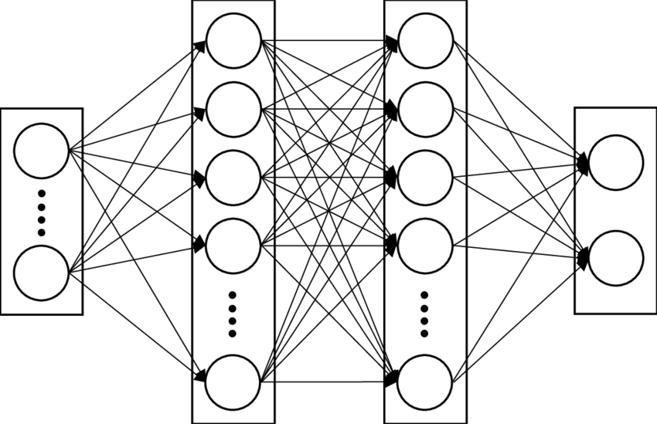
Neural Network
Input
Layer
Output
Layer
Hidden Layers

Slide 3
Inductive Bias
Set of (explicit or implicit) assumptions made by a learning algorithm in order to perform prediction
For example,
Linearity assumption in Linear Regression and Logistic Regression
Fully-connected structure of the neural network
Hierarchical Representation Bias
Others ….

Slide 4
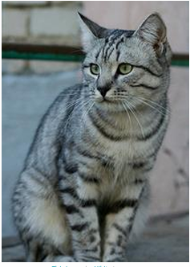
Image Classification
Core task in Computer Vision
Given an image and a set of labels
Cat
Dog
Plane
Truck

Slide 5
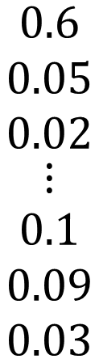
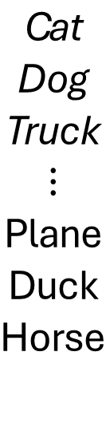
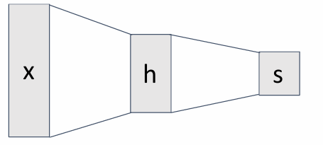
Image Classification
Core task in Computer Vision
Given an image and a set of 10 labels
10 neurons on the output layer

Slide 6
Image Classification
Core task in Computer Vision
Given a set of 10 labels
Flatten
10 neurons on the output layer
The spatial structure of images is destroyed!

Slide 7
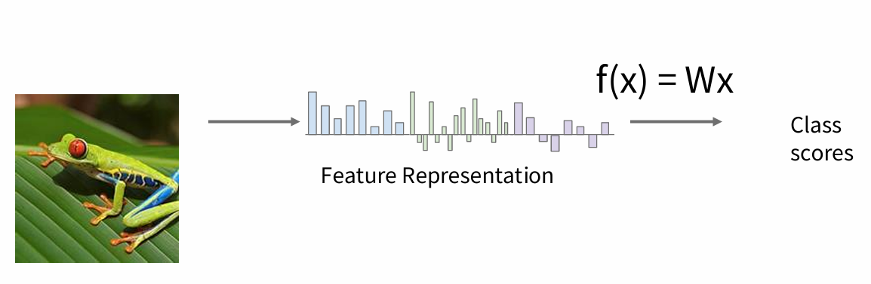
Feature Extraction

Slide 8
Feature Extraction
Color histogram
HOG
Random Patches
Feature engineering

Slide 9
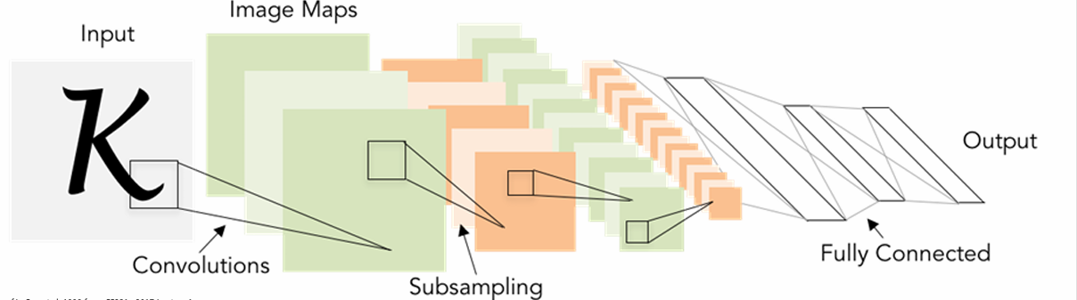
Convolutional Neural Networks
Feature Extraction
Fully Connected Neural Network

Slide 10
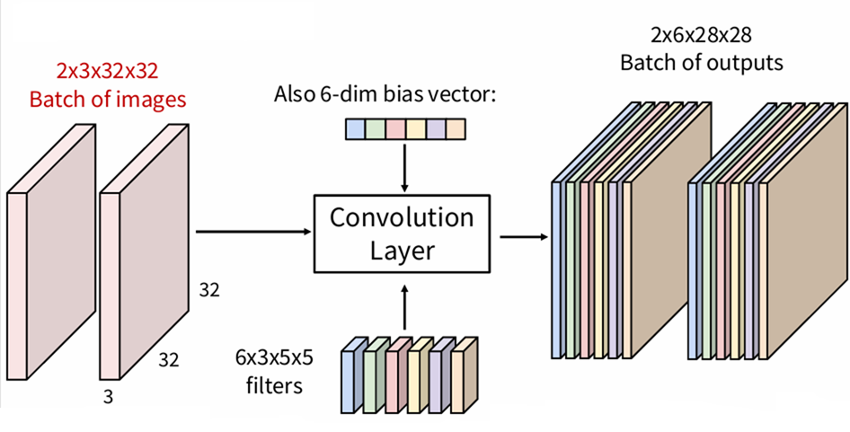
Convolutional Neural Networks
Convolution Layer

Slide 11
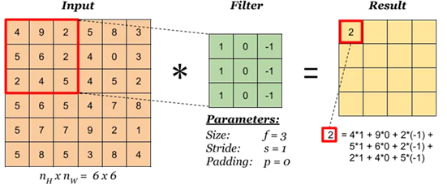
Convolutional Neural Networks
Convolution Layer
A convolution operation

Slide 12
Convolutional Neural Networks
Convolution Layer
Stride
Here stride is1

Slide 13
Convolutional Neural Networks
Convolution Layer

Slide 14
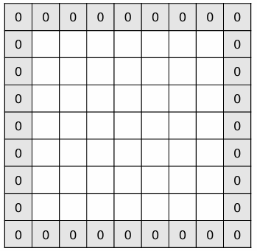
Convolutional Neural Networks
Convolution Layer
Padding
Avoid down-sampling with zero-padding.

Slide 15
Convolutional Neural Networks
Convolution Layer
Padding
Avoid down-sampling with zero-padding.
Input size W
Filter size K
Padding size P
Output size W – K + 1 + 2P

Slide 16
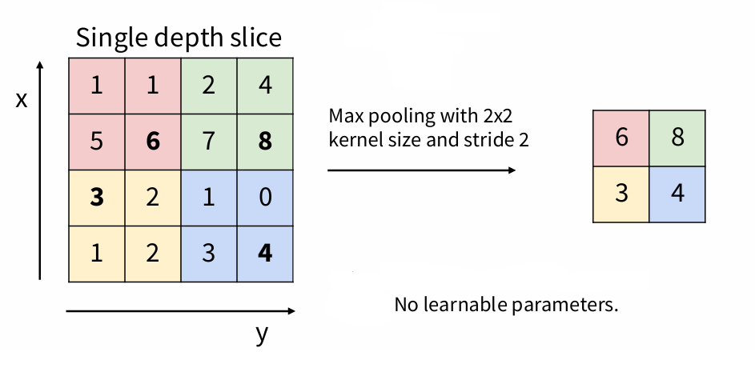
Convolutional Neural Networks
Pooling
A way to downsample
No learnable parameters
Max Pooling
Average Pooling

Slide 17
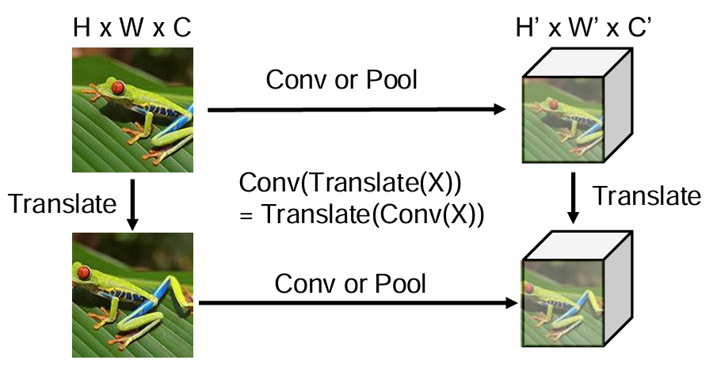
Convolution and Pooling
Translation Equivariance

Slide 18
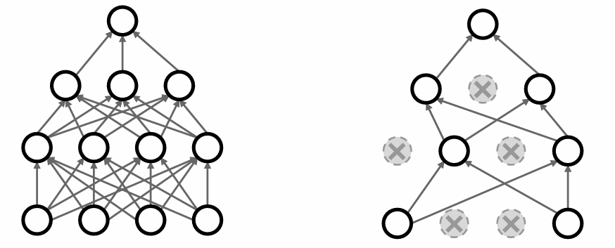
Dropout
In each forward pass, randomly set some neurons to zero
Probability of dropping is a hyperparameter; 0.5 is common

Slide 19
Dropout
Why dropout is necessary?
As if training a large ensemble of models but sharing parameters
Each binary mask is one model
Dropout is used only at training time, no dropout at test time

Slide 20
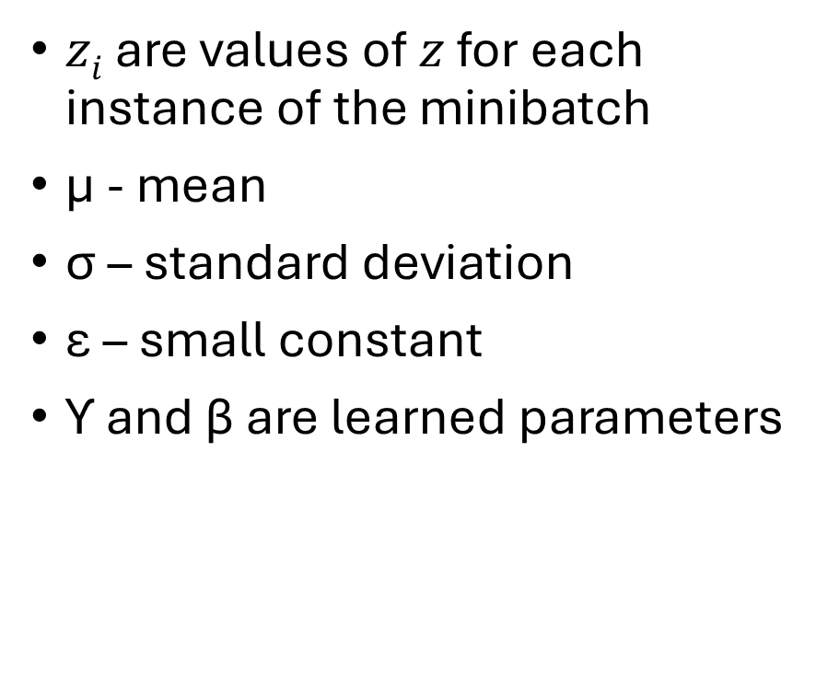
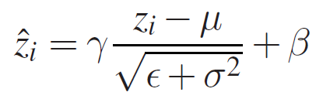
Batch Normalization

Slide 21
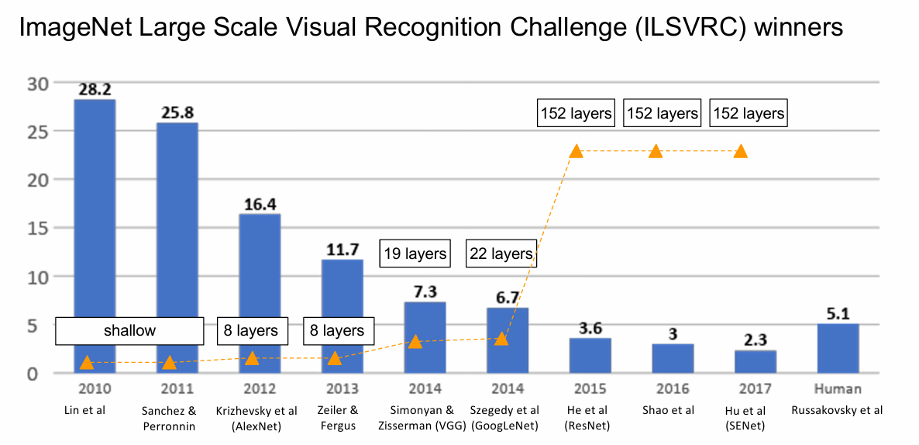
CNN Architectures

Slide 22
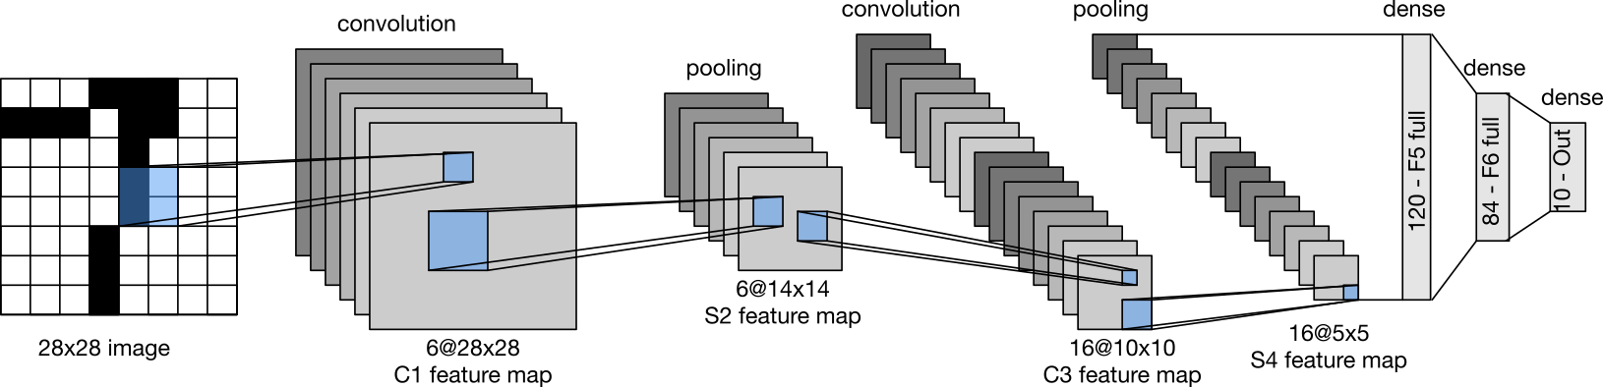
Lenet

Slide 23
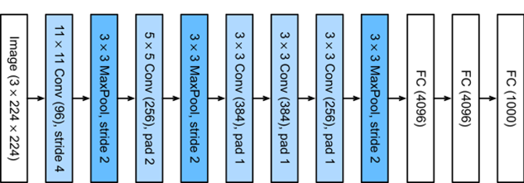
Alexnet

Slide 24
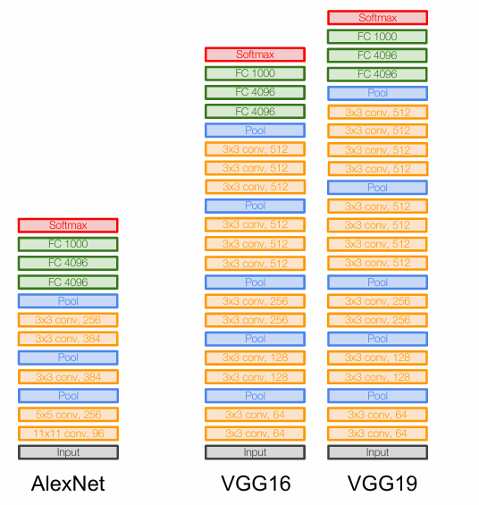
VGG
Only uses 3*3 convolution layers
Why?

Slide 25
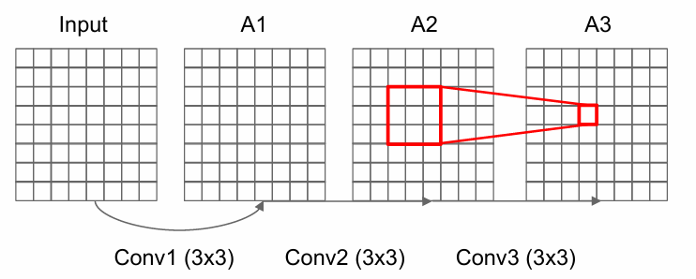
VGG
Only uses 3*3 convolution layers
Why?

Slide 26
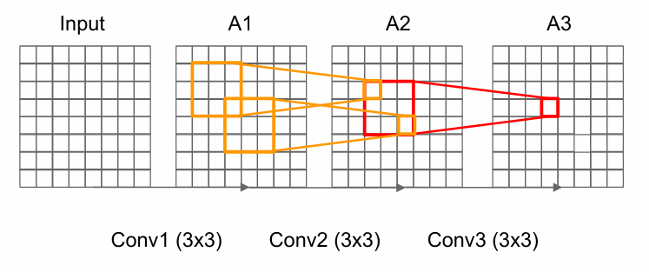
VGG
Only uses 3*3 convolution layers
Why?

Slide 27
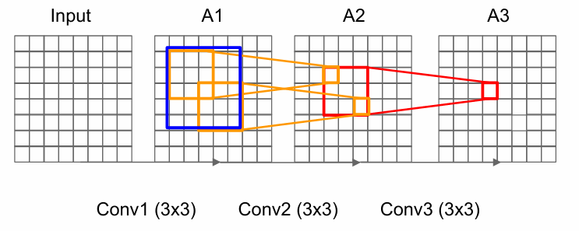
VGG
Only uses 3*3 convolution layers
Why?

Slide 28
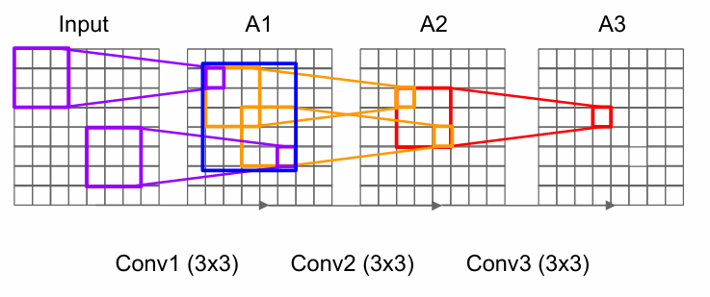
VGG
Only uses 3*3 convolution layers
Why?

Slide 29
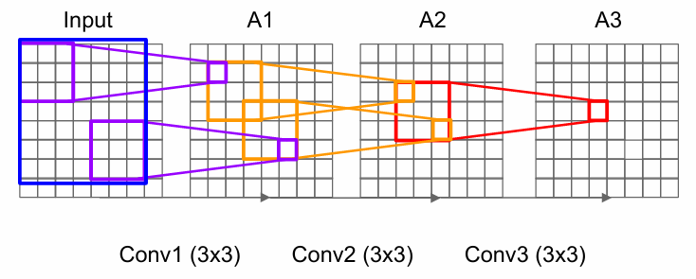
VGG
Only uses 3*3 convolution layers
Why?
Effective receptive field as one 7*7 conv layer

Slide 30
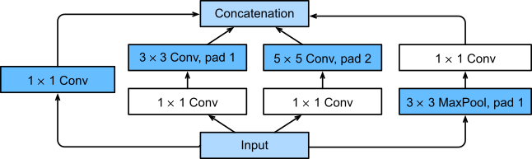
GoogLenet
Investigated which kernel size is the best
Employ a combination of various size kernels
Basic building block is called inception block

Slide 31
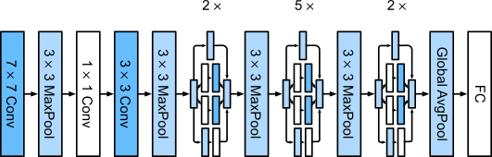
GoogLenet
Investigated which kernel size is the best
Employ a combination of various size kernels
Basic building block is called inception block

Slide 32
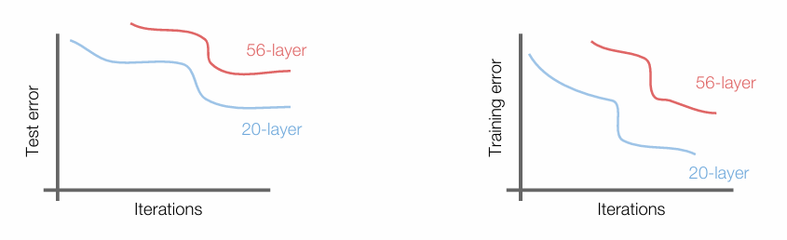
Resnet
Continue stacking layer to train deeper networks.
56-layer model performs worse on both test and training error.

Slide 33
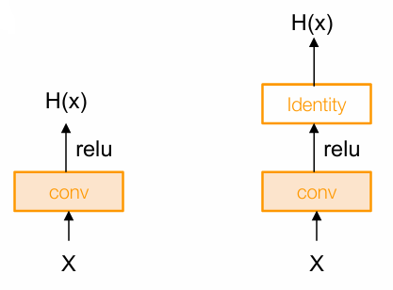
Resnet
The deeper model should learn to be at least as good as the shallower model
Proof by Construction
Copying the learned layers from the shallower model and set additional layers to identity mapping.

Slide 34
Resnet
Deep models have more representation power (more parameters) than shallower models.
Hypothesis: the problem is an optimization problem, deeper models are harder to optimize

Slide 35
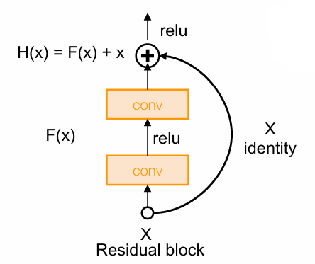
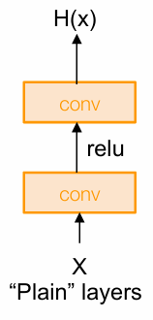
Resnet
Use network layers to fit a residual mapping instead of directly trying to fit a desired underlying mapping
Identity Function,
H(x) = x if F(x) = 0

Slide 36
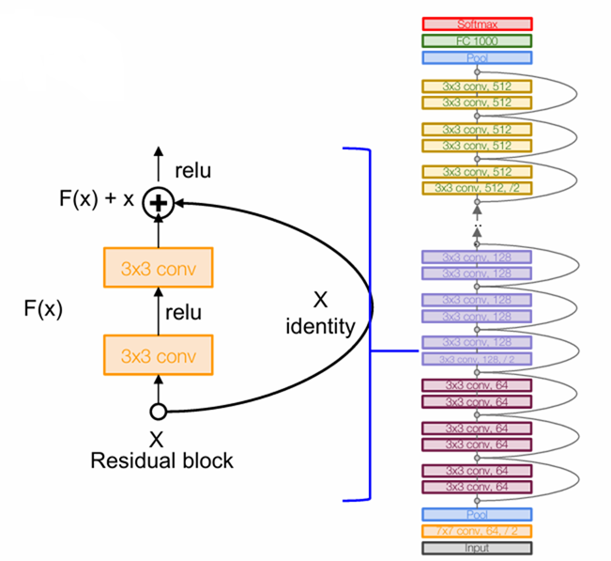
Resnet
Full ResNet architecture
Stack residual blocks
Every residual block has two 3x3 conv layers
Periodically, double # of filters and downsample spatially using stride 2 (/2 in each dimension)
Additional conv layer at the beginning (stem)
As much as 152 layers

Slide 37
Acknowledgement
cs231n.stanford.edu

